Slide 1

✈️ Airline Review Analysis: Web Scraping, Cleaning, and Sentiment Visualization
RAMESH BONALA

Slide 2
AGENDA
Introduction
Web Scraping
Data Cleaning
Sentiment Analysis
Word Cloud Visualization
Sentiment Distribution
Conclusion

Slide 3
Introduction
Purpose: Analyze customer reviews of Qatar Airways.
Techniques used:
Web Scraping with BeautifulSoup
Text Cleaning with NLTK
Sentiment Analysis using TextBlob
Data Visualization with Matplotlib and WordCloud
Goal: Extract meaningful insights from customer feedback.

Slide 4
Tools & Libraries
Python Libraries:
requests, BeautifulSoup → Web scraping
pandas → Data manipulation
nltk, textblob → Text analysis and sentiment detection
wordcloud, matplotlib → Visualization

Slide 5

Web Scraping
Website: airlinequality.com
Process:
Fetched HTML using requests
Parsed review text using BeautifulSoup
Stored data into a structured DataFrame
📊 Result: Multiple real customer reviews collected successfully.

Slide 6
Data Cleaning
Converted all text to lowercase
Removed special characters, numbers, punctuation
Removed common stopwords (e.g., "the", "is", "and")
Specifically removed the word "flight"
Created a cleaned version of the text

Slide 7

Sentiment Analysis
Tool: TextBlob library
Method: Calculated sentiment polarity for each review
Positive (> 0)
Neutral (= 0)
Negative (< 0)
📈 Result: Each review now carries a numerical sentiment score.

Slide 8
Word Cloud Visualization
Combined all cleaned reviews into a single text body
Created a WordCloud image showing most frequent words
Removed background noise words (like "flight")
🖼️ Visual: (Insert WordCloud image from your output)

Slide 9
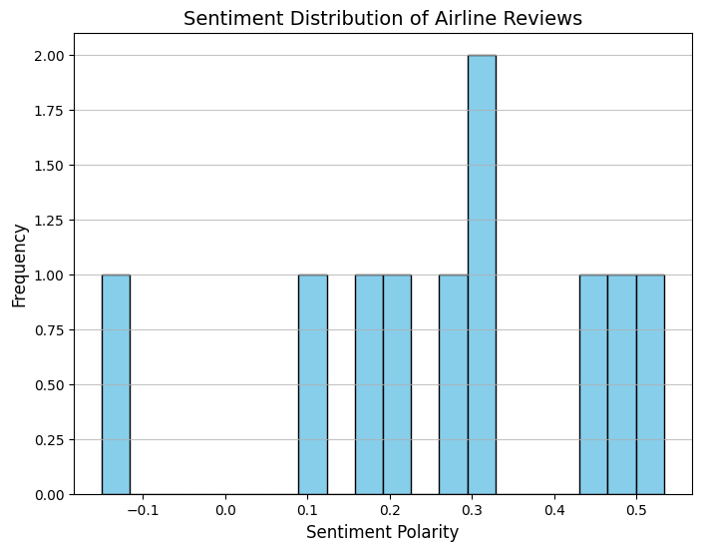
Sentiment Distribution
Plotted a histogram of sentiment scores
Observed the overall spread:
Majority positive?
Negative spikes?
📊 Visual:

Slide 10
Conclusion
Successfully scraped and analyzed airline customer reviews
Built a simple sentiment analysis model without heavy machine learning
Visualized key insights through WordCloud and histograms
Future Work:
Scrape multiple pages for larger datasets
Apply deep learning sentiment models

Slide 11

Thank You

